Slide 1
Text in User Interfaces
COMPSCI 345 / SOFTENG 350
Adapted from slides by Safurah Abdul Jalil & Beryl Plimmer 2011
Based on Heim Chapter 12 & HCI Encyclopedia Chapter 5.1

Slide 2
Learning Outcomes
Describe the main purposes of text in user interface designs
Appreciate the balance between art fonts and readability
Explain what makes a font readable (or not)
Identify and utilise the characteristics of text that we can control
Select an appropriate font scheme for a user interface design

Slide 3
Human Issues
The Reading Purpose
Continuous process (reading a novel)
Scanning
Reading interface - screen or paper
Paper offers physical cues that are lost in simple online paradigms such as a scrolling window
We often rely on our spatial memory when we search for information
Paper can be easier to manipulate for reading comfort and ideal viewing (less fatiguing)
Systems such as Kindle are approaching books on this
Then again, screen is great for text search
Place holders

Slide 4
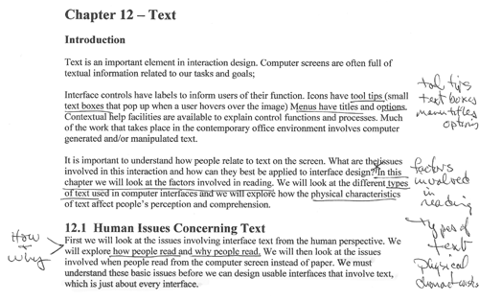
Human Issues
Active reading aids comprehension
Using your pen to follow lines
Annotating the text
Beryl’s group has done quite a lot of annotation research. Have a look here http://www.cs.auckland.ac.nz/research/hci/digital_ink/annotation_tools/index.shtml

Slide 5
Text in Interaction Design
Commentary/Instrumental
Commentary text is text that informs
Instrumental text is text that works; e.g. hyperlinks, button, labels (this will be covered in the lecture on forms & controls)
Legibility
Can the reader discern the words?
Readability
Can the reader easily read the text?
Physical Factors
What is the screen resolution, brightness?

Slide 6
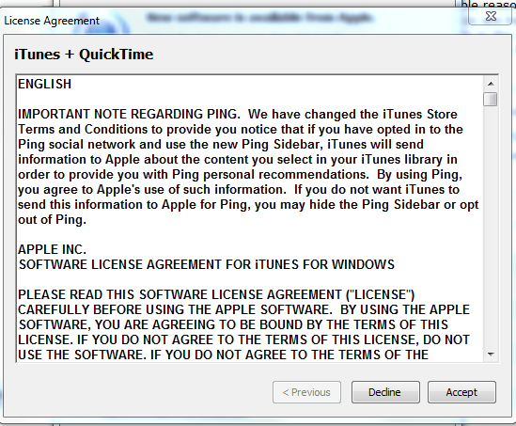
Remember the reading process
We read lowercase more quickly than UPPERCASE
Lowercase presentation is more common
Except when people don’t want you to read it ☹
Do they want you to read the chocolate bar wrapper?

Slide 7
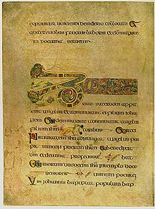
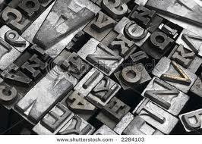
Typography craft and an art
Art
Book of Kells (6th century)
Craft
Arranging glyphs (letters)
Dates from earliest printing presses
Its history is evident in the terms we use
Leading … the amount of lead between lines

Slide 8
Basic Anatomy of letterforms
Image modified from http://26.media.tumblr.com/tumblr_kx1onhPpD61qajttoo1_500.gif

Slide 9
Fonts: serif & sans serif
http://www.pixel77.com/typography-type-and-typefaces/
‘Sans’ is “without”, therefore sans serif fonts are fonts without serifs
People still argue whether serif (e.g. Georgia) or sans serif (e.g. Arial) is easier to read on a screen
http://www.w3schools.com/cssref/playit.asp?filename=playcss_font-family
CSS definition: p.ex2 { font:15px Georgia, serif;}
Use in HTML: <p class="ex2">Georgia</p>
Georgia, Verdana, and Trebuchet maintain legibility at small sizes and have been designed to facilitate reading on the Web

Slide 10
Fonts for title vs. body
Decorative/Display fonts
Decorative fonts (sometimes called display fonts or title fonts)
suitable for titles and headings
strong personality:
grab people’s attention
reinforce the message of the word.
May not be installed on all machines – in which case you need to have a default!
Neutral looking fonts such Georgia or Arial are more suitable as body copy (easier to read)

Slide 11
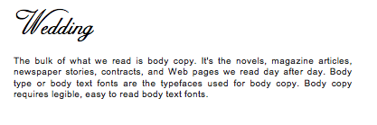
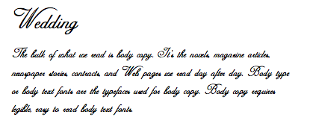
Fonts for title vs. body

Slide 12
Fonts: proportional & monospaced
http://library.kiwix.org:4201/A/Typeface.html
A proportional font has variable-width: ioioioioio
A monospaced font has fixed-width ioioioioio

Slide 13
Font Size
Factors that affect perceived font size:
Reading Distance—Greater distances require larger text.
Screen Resolution—Smaller text requires greater resolution to keep the characters clear and legible.
Text/Background Contrast—Positive contrast is optimal (black type on a white background).
Visual Acuity of User—Not all users have 20/20 vision. And from age 40-something presbyopia really takes hold: focusing on near objects doesn’t work so well and hence small fonts require magnification
Purpose —Text can be scanned, read word by word, or read character by character [e.g. passwords]

Slide 14
Font Size
Fonts for body copy usually don't work well when set too large, they tend to become inelegant and clunky.
The opposite is the case when setting titling fonts too small – the title/heading will lose its dominance and the page looks bland.

Slide 15
Font Size
Fonts of the same size, say 11pt, will sometimes look different in size due to their different x-heights.
http://www.pixel77.com/typography-type-and-typefaces/
These fonts are all in the same size (36pt):
a a a a
Looks bigger Looks smaller
http://www.w3schools.com/cssref/tryit.asp?filename=trycss_font with p.ex1 { font:15px Times New Roman, serif;} p.ex2 { font:15px Book Antiqua, serif;}

Slide 16
Weight & Style
Weight
Bold
When two fonts differ in weight, they form a strong and vibrant visual contrast. e.g. between heading, and body – as we have on this page
Style
Italics
Underline
Underlines will be mistaken as a hyperlink
so don’t use except for links
Besides emphasizing points, creating contrast by varying weight and style can contribute to a dramatic and eye-catching look to an interface. It helps keep your page from looking dull.
However, use with restraint and be consistent.
too many weight and styles on one screen gets confusing.

Slide 17
Spacing
Vertical line spacing
The spacing between lines of text (single spacing, double spacing, etc.) is called leading or line height
Increasing spacing improves reading speed
But takes more screen space
Different languages need different amounts of leading
Korean needs lots more because letters are stacked
Examples: http://www.w3schools.com/cssref/tryit.asp?filename=trycss_line-height http://www.w3schools.com/cssref/playit.asp?filename=playcss_line-height

Slide 18
Alignment
Alignment
Use left or justified
Right and centre are harder to read because can’t easily find beginning of the line
Right justification is good to glue caption text to a data entry field or figure to the right
This is a paragraph of writing. This is a paragraph of writing. This is a paragraph of writing. This is a paragraph of writing.
This is a paragraph of writing. This is a paragraph of writing. This is a paragraph of writing. This is a paragraph of writing. This is a paragraph of writing.
This is a paragraph of writing. This is a paragraph of writing. This is a paragraph of writing. This is a paragraph of writing. This is a paragraph of writing.

Slide 19
Line Length & Margins
Line length
Line length affects reading performance (i.e. speed) but not comprehension
Lines of greater length are read more quickly
Up to a limit of perhaps 75-100 characters per line (CPL)
But people prefer medium line lengths
http://www.w3schools.com/cssref/playit.asp?filename=playcss_max-width
Margin width
Shorter lines — 4 inches (2.54cm=1 inch) — with large margins increase reading performance
So generous white space helps performance
http://www.w3schools.com/cssref/playit.asp?filename=playcss_padding-left

Slide 20
Line Length & Margins (contd.)
The research studies on user performance in this area are somewhat mixed
A problem is that different studies have different sort of users, tasks and media – and at different times (people have probably changed their expectations after using smartphones and tablet readers for the last few years)
So try moderate options (medium line length and, if at all possible in terms of layout, generous margins)
But if it’s really critical you should seek feedback from your intended user base and usage context (with a scale of feedback / study commensurate to the scale of the project and criticality of the task)
Same goes for any aesthetic decision really

Slide 21
Learning Outcomes
The main purposes of text?
Reading
Reading versus scanning
Commentary/Instrumental
Output versus interactive
Is there the balance between ‘art’ fonts and readability?
What makes a font readable (or not)?

Slide 22
Learning outcomes
What are the characteristics of text that we can control?
Font
Serif, san serif
Proportional, mono space
Size
Bigger is dominant and easier to read – but takes more screen real estate
Weight
Bold emphasise and increases dominance
Style
Italics and underline (links only) bring focus
Spacing
Increased line height makes it easier to read – but takes more screen real estate
Alignment
Left or justified is easiest to read.
Small margins make it easier to read.
(And colour, too – but that’s its own lecture)
Design a font scheme (in your assignment)

Slide 23
References
Tidwell, J. (2010) Designing Interfaces, Second Edition: Patterns for Effective Interaction Design . O'Reilly Media.
html5 & css 3… with no images http://www.onextrapixel.com/examples/html5-css3-website-layout/
Fun with text http://v1.jontangerine.com/silo/
Heim, S., The Resonant Interface, Chapter 12.

